Slide 1
Data Mining : Implementations
By
Prof.Dr. O.P.Vyas
IIIT- A

Slide 2
D.M.W.
Data Mining
  Association Rule Mining: Apriori Algorithm
  Issues in DM : User-Centric Vs Procedure centric
    Utility Mining issues
    Rare item Problem:Single MinSup problem
  Classification & Predictive mechanism
    Classification & Business Intelligence
    Predictive Accuracy and various classifier accuracies
    Developing BI Solutions and Classification approach
  B.I. : Clustering Analysis
Social Network Analysis & Data Mining

Slide 3
Clustering
Imagine that you are the Director of Customer Relationships at AllElectronics, and you have 05 Managers working for you.
You have customer database which you would like to group all the customers into 05 groups so that each group can be assigned to a different manager.
Strategically you would like that the customers in each group are as similar as possible.
Moreover, two given customers having very different business patterns should not be placed in the same group.
Unlike in Classification, the class label of each customer is unknown.
You want to identify common features shared by the customers and thus has to have similarity and dissimilarity metrics discovered

Slide 4
Clustering is the process of grouping a set of data objects into multiple groups such that
Objects within the clusters have high similarity but are very dissimilar to objects in the other clusters
Given a large number of customers in a database with many features associated to each one of them Ex. Age, Gender, Monthly buying, Type of purchases (Sports, Cosmetics, FMCG, Payment options- Cards/Netbanking, ), with no pre-defined criterion for group but rather to decide the similarity metrics is also known as Unsupervised Learning

Slide 5
What is Cluster Analysis?
Cluster: a collection of data objects
  Similar to one another within the same cluster
  Dissimilar to the objects in other clusters
Cluster analysis
  The process of grouping a set of data objects into clusters
Clustering is unsupervised classification: no predefined classes
Clustering is similar to classification but the groups are not predefined in the clustering.
Typical applications
  As a stand-alone tool to get insight into data distribution
  As a preprocessing step for other algorithms

Slide 6
Supervised vs. Unsupervised Learning
Learning: training data are analyzed by a classification algorithm.
  Supervised learning (classification) Learning of the model is supervised in that it is told to which class each training sample belongs
    Supervision: The training data (observations, measurements, etc.) are accompanied by labels indicating the class of the observations
    New data is classified based on the training set
  Unsupervised learning (clustering)
    The class labels of training data is unknown
    Given a set of measurements, observations, etc. with the aim of establishing the existence of classes or clusters in the data

Slide 7

K-MEANS CLUSTERING
The k-means algorithm is an algorithm to cluster n objects based on attributes into k partitions, where k < n.
An algorithm for partitioning (or clustering) N data points into K disjoint subsets S_{j} containing data points so as to fulfill the given criteria.
An objective function is used to assess the partitioning quality so that
  Objects within a cluster are similar to one another
  But Objects are dissimilar to objects in other clusters.
K-means takes to minimize the sum-of-squares criterion
where x_{n} is a vector representing the the n^{th} data point and u_{j} is the geometric centroid of the data points in S_{j}.

Slide 8

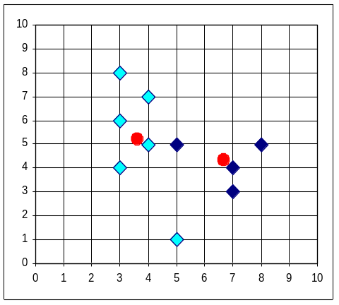


The K-Means Clustering Method
Example
The centroid points are shown for both clusters
Some points are shown as nearer to Second Cluster,
So re-grouping of Clusters

Slide 9
K-Means
Step 1: Begin with a decision on the value of k = number of clusters .
Step 2: Put any initial partition that classifies the data into k clusters. You may assign the training samples randomly,or systematically as the following:
1.Take the first k training sample as single-element clusters
2. Assign each of the remaining (N-k) training sample to the cluster with the nearest centroid. After each assignment, recompute the centroid of the gaining cluster.
Step 3: Take each sample in sequence and compute its distance from the centroid of each of the clusters. If a sample is not currently in the cluster with the closest centroid, switch this sample to that cluster and update the centroid of the cluster gaining the new sample and the cluster losing the sample.
Step 4 . Repeat step 3 until convergence is achieved, that is until a pass through the training sample causes no new assignments

Slide 10

How the K-Mean Clustering algorithm works?

Slide 11
K-Means: Measure of Similarity
Simply speaking k-means clustering is an algorithm to classify or to group the objects based on attributes/features into K number of group.
K is positive integer number.
The grouping is done by minimizing the sum of squares of distances between data and the corresponding cluster centroid.
There are other distance measures also considered for ;
  Distance measures

Slide 12

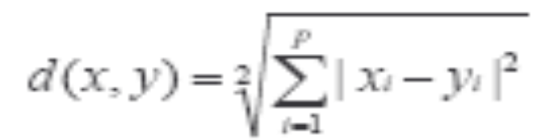
Common Distance measures:
Distance measure will determine how the similarity of two elements is calculated and it will influence the shape of the clusters.
They include:
1. The Euclidean distance (also called 2-norm distance) is given by:
2. The Manhattan distance (also called taxicab norm or 1-norm) is given by:

Slide 13
The K-Means Clustering Method
For Given k=3, the k-means algorithm is implemented in 4 steps:
  Partition objects into 3 nonempty subsets by taking 03 initial objects as 3 initial cluster centers, by assigning each object to a cluster based on the cluster center to which it is nearest
  Compute 03 seed points as the centroids of the clusters of the current partition. The centroid is the center (mean point) of the cluster.
  Assign each object to the cluster with the nearest seed point. This kind of grouping will update the Cluster centers.(Mean value of each cluster is recalculated based on the objects in the cluster)
  Go back to Step 2, stop when no more new assignment.

Slide 14
Comments on the K-Means Method
Strength
  Relatively efficient: O(tkn), where n is # objects, k is # clusters, and t is # iterations. Normally, k, t << n.
  Often terminates at a local optimum. The global optimum may be found using techniques such as: deterministic annealing and genetic algorithms
Weakness
  Applicable only when mean is defined, then what about categorical data?
  Need to specify k, the number of clusters, in advance
  Unable to handle noisy data and outliers
  Not suitable to discover clusters with non-convex shapes

Slide 15
Clustering
What is a good Clustering ?
Similarity / dissimilarity metrics for Clustering?
Major Clustering Approaches
  Partitioning methods
  Hierarchical methods
  Density based methods
Outlier Analysis
    What is outlier ?
    Why & How ?

Slide 16
What Is Good Clustering?
A good clustering method will produce high quality clusters with
  high intra-class similarity
  low inter-class similarity
The quality of a clustering result depends on both the similarity measure used by the method and its implementation.
The quality of a clustering method is also measured by its ability to discover some or all of the hidden patterns.

Slide 17
Typical Alternatives to Calculate the Distance between Clusters
Single link: smallest distance between an element in one cluster and an element in the other, i.e., dis(K_{i}, K_{j}) = min(t_{ip}, t_{jq})
Complete link: largest distance between an element in one cluster and an element in the other, i.e., dis(K_{i}, K_{j}) = max(t_{ip}, t_{jq})
Average: avg distance between an element in one cluster and an element in the other, i.e., dis(K_{i}, K_{j}) = avg(t_{ip}, t_{jq})
Centroid: distance between the centroids of two clusters, i.e., dis(K_{i}, K_{j}) = dis(C_{i}, C_{j})
Medoid: distance between the medoids of two clusters, i.e., dis(K_{i}, K_{j}) = dis(M_{i}, M_{j})
  Medoid: one chosen, centrally located object in the cluster
Data Mining: Concepts and Techniques

Slide 18
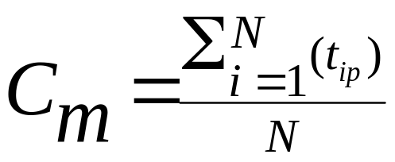
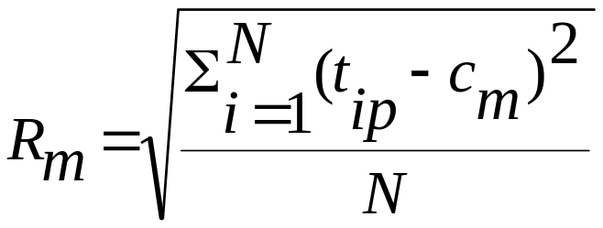

Centroid, Radius and Diameter of a Cluster (for numerical data sets)
Centroid: the “middle” of a cluster
Radius: square root of average distance from any point of the cluster to its centroid
Diameter: square root of average mean squared distance between all pairs of points in the cluster

Slide 19
General Applications of Clustering
Pattern Recognition
Spatial Data Analysis
  create thematic maps in GIS by clustering feature spaces
  detect spatial clusters and explain them in spatial data mining
Image Processing
Economic Science (especially market research)
WWW
  Document classification
  Cluster Weblog data to discover groups of similar access patterns
Data Mining: Concepts and Techniques

Slide 20
Examples of Clustering Applications
Marketing: Help marketers discover distinct groups in their customer bases, and then use this knowledge to develop targeted marketing programs
Land use: Identification of areas of similar land use in an earth observation database
Insurance: Identifying groups of motor insurance policy holders with a high average claim cost
City-planning: Identifying groups of houses according to their house type, value, and geographical location
Earth-quake studies: Observed earth quake epicenters should be clustered along continent faults
Data Mining: Concepts and Techniques

Slide 21
Requirements of Clustering in Data Mining
Scalability
Ability to deal with different types of attributes
Discovery of clusters with arbitrary shape
Minimal requirements for domain knowledge to determine input parameters
Able to deal with noise and outliers
Insensitive to order of input records
High dimensionality
Incorporation of user-specified constraints
Interpretability and usability

Slide 22
Major Clustering Approaches
Partitioning algorithms: Construct various partitions and then evaluate them by some criterion
Hierarchy algorithms: Create a hierarchical decomposition of the set of data (or objects) using some criterion
  Agglomerative or Divisive
Density-based: based on connectivity & density functions
Grid-based: based on a multiple-level granularity structure
Model-based: A model is hypothesized for each of the clusters and the idea is to find the best fit of that model to each other
Outlier Discovery:
Data Mining: Concepts and Techniques

Slide 23
Partitioning Algorithms: Basic Concept
Partitioning method: Construct a partition of a database D of n objects into a set of k clusters
Given a k, find a partition of k clusters that optimizes the chosen partitioning criterion
  Global optimal: exhaustively enumerate all partitions
  Heuristic methods: k-means and k-medoids algorithms
  k-means (MacQueen’67): Each cluster is represented by the center of the cluster
  k-medoids or PAM (Partition around medoids) (Kaufman & Rousseeuw’87): Each cluster is represented by one of the objects in the cluster

Slide 24

Variations of the K-Means Method
A few variants of the k-means which differ in
  Selection of the initial k means
  Dissimilarity calculations
  Strategies to calculate cluster means
Handling categorical data: k-modes (Huang’98)
  Replacing means of clusters with modes. Why?
  Using new dissimilarity measures to deal with categorical objects
  Using a frequency-based method to update modes of clusters
  A mixture of categorical and numerical data: k-prototype method

Slide 25
Mode
In statistics, the mode is the value that occurs the most frequently in a data set or a probability distribution.
  In some fields, notably education, sample data are often called scores, and the sample mode is known as the modal score.
Like the statistical mean and the median, the mode is a way of capturing important information about a random variable or a population in a single quantity.
The mode is in general different from the mean and median, and may be very different for strongly skewed distributions.
The mode is not necessarily unique, since the same maximum frequency may be attained at different values. The most ambiguous case occurs in uniform distributions, wherein all values are equally likely.

Slide 26
What Is the Problem of the K-Means Method?
The k-means algorithm is sensitive to outliers !
  Since an object with an extremely large value may substantially distort the distribution of the data.
  Consider 06 points in 1-D space, {1,2,3,8,9,10 and 25}
  {1,2,3} and {8,9,10,25} looks like two clusters
  Means of the first cluster being 2 while {8,9,10,25} will have mean as 13.
  In fact 25 being an Outlier is disturbing the distribution.
Instead of taking means as reference point, we can pick actual object representational object per cluster !
  Principle of minimizing an object with Sum of the dissimilarities between each object p and corresponding representational object is basis of k-Medoid method.
Data Mining: Concepts and Techniques

Slide 27
What Is the Problem of the K-Means Method?
K-Medoids: Instead of taking the mean value of the object in a cluster as a reference point, medoids can be used, which is the most centrally located object in a cluster.
Each remaining object is clustered with the representative object to which it is most similar.
The partitioning method is then performed based on the principle of minimizing the sum of the dissimilarities between each object and its corresponding reference point.
10
10
9
9
8
8
7
7
6
6
5
5
4
4
3
3
2
2
1
1
0
0
0
1
2
3
4
5
6
Data Mining: Concepts and Techniques
0
1
2
3
4
5
6
7
8
9
10
7
8
9
10

Slide 28
The K-Medoids Clustering Method
Find representative objects, called medoids, in clusters
PAM (Partitioning Around Medoids, 1987)
  starts from an initial set of medoids and iteratively replaces one of the medoids by one of the non-medoids if it improves the total distance of the resulting clustering
  PAM works effectively for small data sets, but does not scale well for large data sets
CLARA (Kaufmann & Rousseeuw, 1990)
CLARANS (Ng & Han, 1994): Randomized sampling
Focusing + spatial data structure (Ester et al., 1995)
Data Mining: Concepts and Techniques

Slide 29

A Typical K-Medoids Algorithm (PAM)
Total Cost = 20
10
9
8
Arbitrary choose k object as initial medoids
Assign each remaining object to nearest medoids
7
6
5
4
3
2
1
0
0
1
2
3
4
5
6
7
8
9
10
K=2
Randomly select a nonmedoid object,O_{ramdom}
Total Cost = 26
Do loop
Until no change
10
10
9
Compute total cost of swapping
9
Swapping O and O_{ramdom}
If quality is improved.
8
8
7
7
6
6
5
5
4
4
3
3
2
2
1
1
0
Data Mining: Concepts and Techniques
0
1
2
3
4
5
6
7
8
9
10
0
0
1
2
3
4
5
6
7
8
9
10

Slide 30
PAM (Partitioning Around Medoids) (1987)
PAM (Kaufman and Rousseeuw, 1987), built in Splus
Use real object to represent the cluster
  Select k representative objects arbitrarily
  For each pair of non-selected object h and selected object i, calculate the total swapping cost TC_{ih}
  For each pair of i and h,
    If TC_{ih} < 0, i is replaced by h
    Then assign each non-selected object to the most similar representative object
  repeat steps 2-3 until there is no change
Data Mining: Concepts and Techniques

Slide 31
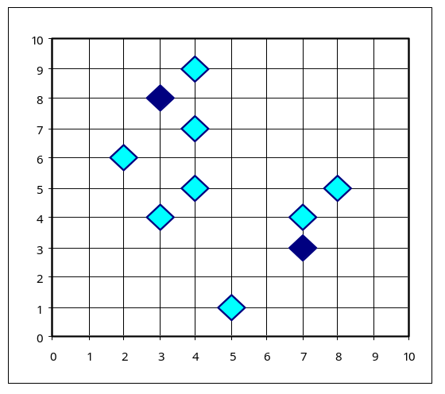
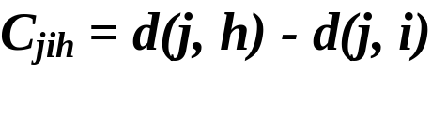

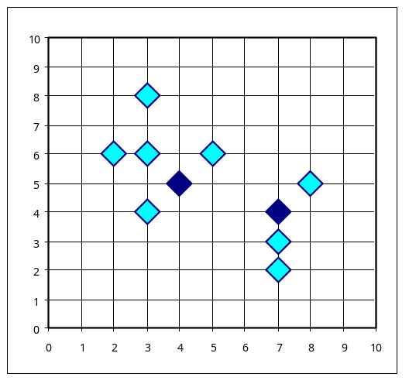
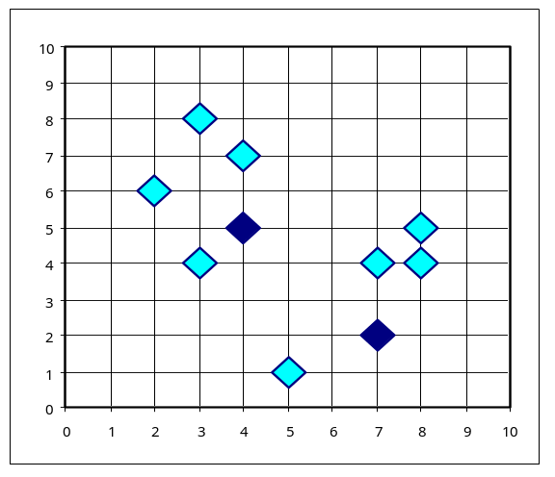


PAM Clustering: Total swapping cost TC_{ih}=∑_{j}C_{jih}
t
j
t
j
i
h
h
i
h
j
i
i
t
h
j
t
Data Mining: Concepts and Techniques

Slide 32
What Is the Problem with PAM?
Pam is more robust than k-means in the presence of noise and outliers because a medoid is less influenced by outliers or other extreme values than a mean
Pam works efficiently for small data sets but does not scale well for large data sets.
  O(k(n-k)² ) for each iteration
where n is # of data,k is # of clusters
Sampling based method,
CLARA(Clustering LARge Applications)
Data Mining: Concepts and Techniques

Slide 33
CLARA (Clustering Large Applications) (1990)
CLARA (Kaufmann and Rousseeuw in 1990)
  Built in statistical analysis packages, such as S+
It draws multiple samples of the data set, applies PAM on each sample, and gives the best clustering as the output
Strength: deals with larger data sets than PAM
Weakness:
  Efficiency depends on the sample size
  A good clustering based on samples will not necessarily represent a good clustering of the whole data set if the sample is biased
Data Mining: Concepts and Techniques

Slide 34
The K-Medoids Clustering Method
Find representative objects, called medoids, in clusters
PAM (Partitioning Around Medoids, 1987)
CLARA (Kaufmann & Rousseeuw, 1990)
CLARANS (Ng & Han, 1994): Randomized sampling
Focusing + spatial data structure (Ester et al., 1995)
Data Mining: Concepts and Techniques

Slide 35
CLARANS (“Randomized” CLARA)
CLARANS (A Clustering Algorithm based on Randomized Search) (Ng and Han’94)
CLARANS draws sample of neighbors dynamically
The clustering process can be presented as searching a graph where every node is a potential solution, that is, a set of k medoids
If the local optimum is found, CLARANS starts with new randomly selected node in search for a new local optimum
It is more efficient and scalable than both PAM and CLARA
Focusing techniques and spatial access structures may further improve its performance (Ester et al.’95)
Data Mining: Concepts and Techniques

Slide 36
Hierarchical Clustering
In some situation we may want to partition our data into groups at different levels such as a hierarchy.
  A hierarchical clustering methods works by grouping data objects into “tree” of clusters.
  Representing data objects in hierarchy is useful for data visualization and summarization.
This method does not require the number of clusters k as an input, but needs a termination condition.
Hierarchical methods face the issues regarding the selection of merge or split points in clustering process.

Slide 37
Dendrogram: Shows How the Clusters are Merged
  A tree structure called a dendogram is commonly used to represent the process of hierarchical clustering.
  Decompose data objects into a several levels of nested partitioning (tree of clusters), called a dendrogram.
  A clustering of the data objects is obtained by cutting the dendrogram at the desired level, then each connected component forms a cluster.
Data Mining: Concepts and Techniques

Slide 38
Hierarchical Clustering
Uses hierarchical decomposition of the given distance matrix as clustering criteria.
This method does not require the number of clusters k as an input, but needs a termination condition.
Can be classified as being either Agglomerative or Divisive, based on how the hierarchical decomposition is formed.
  Agglomerative approach
  Divisive Approach

Slide 39
Agglomerative vs Divisive Approach
Also known as Bottom Up strategy, starts by placing each object in its own cluster and then merges these atomic clusters into larger and larger clusters,
  until all of the objects are in a single cluster
Or
  Until certain termination conditions are satisfied .
Divisive Approach employs a top-down approach. It starts by placing all objects in one cluster, which is the hierarchical root. It then divides the root cluster into several smaller subclusters, and recursively partitions those clusters into smaller ones

Slide 40
Agglomerative Approach
Also known as Bottom Up strategy, starts by placing each object in its own cluster and then merges these atomic clusters into larger and larger clusters,
  until all of the objects are in a single cluster
Or
  Until certain termination conditions are satisfied .
Most hierarchical clustering methods belong to this category.
They differ only in their definition of inter-cluster similarity

Slide 41
AGNES Vs DIANA
AGGLOMERATIVE VS DIVISIVE

Slide 42
Agglomerative Nesting to a data set of 5 objects {a,b,c,d,e}.
Initially each object is placed into a cluster of its own.
The clusters are then merged (based on some criterion) in step-by-step manner 1
Agglomerative
(AGNES)
Step 0
Step 1
Step 2
Step 3
Step 4
a
a b
b
a b c d e
c
c d e
d
d e
e
divisive
(DIANA)
Step 4
Step 3
Step 2
Step 1
Step 0
Data Mining: Concepts and Techniques

Slide 43

AGNES (Agglomerative Nesting)
Introduced in Kaufmann and Rousseeuw (1990)
Implemented in statistical analysis packages, e.g., Splus
Use the Single-Link method and the dissimilarity matrix.
Merge nodes that have the least dissimilarity
Go on in a non-descending fashion
Eventually all nodes belong to the same cluster
Data Mining: Concepts and Techniques

Slide 44
Divisive Analysis Clustering
Use distance matrix as clustering criteria. This method does not require the number of clusters k as an input, but needs a termination condition
Step 0
Step 1
Step 2
Step 3
Step 4
a
a b
b
a b c d e
c
c d e
d
d e
e
Divisive
(DIANA)
Step 4
Step 3
Step 2
Step 1
Step 0
Data Mining: Concepts and Techniques

Slide 45
DIANA (Divisive Analysis)
Introduced in Kaufmann and Rousseeuw (1990)
Implemented in statistical analysis packages, e.g., Splus
Inverse order of AGNES
Eventually each node forms a cluster on its own
Data Mining: Concepts and Techniques

Slide 46
Recent Hierarchical Clustering Methods
Major weakness of agglomerative clustering methods
  do not scale well: time complexity of at least O(n²), where n is the number of total objects
  can never undo what was done previously
Integration of hierarchical with distance-based clustering
  BIRCH (1996): uses CF-tree and incrementally adjusts the quality of sub-clusters
  ROCK (1999): clustering categorical data by neighbor and link analysis
  CHAMELEON (1999): hierarchical clustering using dynamic modeling
Data Mining: Concepts and Techniques

Slide 47
BIRCH (1996)
Birch: Balanced Iterative Reducing and Clustering using Hierarchies (Zhang, Ramakrishnan & Livny, SIGMOD’96)
Incrementally construct a CF (Clustering Feature) tree, a hierarchical data structure for multiphase clustering
  Phase 1: scan DB to build an initial in-memory CF tree (a multi-level compression of the data that tries to preserve the inherent clustering structure of the data)
  Phase 2: use an arbitrary clustering algorithm to cluster the leaf nodes of the CF-tree
Scales linearly: finds a good clustering with a single scan and improves the quality with a few additional scans
Weakness: handles only numeric data, and sensitive to the order of the data record.
Data Mining: Concepts and Techniques

Slide 48
Clustering Feature Vector in BIRCH
Clustering Feature: CF = (N, LS, SS)
N: Number of data points
LS: ∑^{N}_{i=1}=X_{i}
SS: ∑^{N}_{i=1}=X_{i}²
CF = (5, (16,30),(54,190))
(3,4)
(2,6)
(4,5)
(4,7)
(3,8)
Data Mining: Concepts and Techniques

Slide 49
Clustering Approaches: Overview

Slide 50
Clustering Approaches
Partitioning algorithms :
  Given a database D of n objects, a partitioning method constructs a set of k clusters.
  Where each partition is a cluster and k< =n.
      Each group must contain atleast one object
      Each object must belong to exactly one group.
Given a k, find a partition of k clusters that optimizes the chosen partitioning criterion

Slide 51
Hierarchical methods
Creates hierarchical decomposition of the given set of data objects.
Agglomerative approach starts with each object forming a separate group, it successively merges the objects into groups until all the objects are merged into one or till termination condition is fulfilled.
Divisive approach starts with all the data items into one and in successive iteration the data objects are splited into smaller cluster until all the objects are grouped as each being one cluster or till termination condition is fulfilled.

Slide 52
Partitioning Algorithms: Basic Concept
Partitioning method: Construct a partition of a database D of n objects into a set of k clusters
Given a k, find a partition of k clusters that optimizes the chosen partitioning criterion
  Global optimal: exhaustively enumerate all partitions
  Heuristic methods: k-means and k-medoids algorithms
  k-means (MacQueen’67): Each cluster is represented by the center of the cluster
  k-medoids or PAM (Partition around medoids) (Kaufman & Rousseeuw’87): Each cluster is represented by one of the objects in the cluster

Slide 53
Cluster Analysis
What is Cluster Analysis?
Types of Data in Cluster Analysis
A Categorization of Major Clustering Methods
Partitioning Methods
Hierarchical Methods
Density-Based Methods
Grid-Based Methods
Model-Based Clustering Methods
Outlier Analysis
Summary

